Slide 1
QUANTIFYING THE BENEFITS OF WATERSHED-SCALE UPLAND RESTORATION
Maggie Gallagher and Brett Milligan, UC Davis
Bay-Delta Science Conference - September 29, 2026

Slide 2

NEW GREEN WATERSHED SCENARIO
How would large-scale restoration of key upland habitat types affect the Delta?
Montane forests
Wet meadows
Floodplains

Slide 3
APPROACH: LITERATURE REVIEW + SCENARIO-BASED MODELING
Reviewed key conceptual + quantitative papers on benefits of restoring each landscape
Compared measurements/results across papers to create area-based metrics for each benefit of restoration
Applied per-area metrics to restoration scenarios to estimate effects of large-scale restoration

Slide 4
APPROACH: EXPERT FORUMS
Thank you to the experts + practitioners that have reviewed and informed this work!
Gabrielle Boisramé, University of Nevada, Reno
John Cain, River Partners
Dylan Chapple, Delta Stewardship Council
Jeff Jenkins, UC Merced
Jennifer Natali, UC Berkeley
Cody Reed, Point Blue Conservation Science
Andrew Schwartz, Department of Water Resources
John Stella, SUNY ESF
Sarah Yarnell, UC Davis

Slide 5
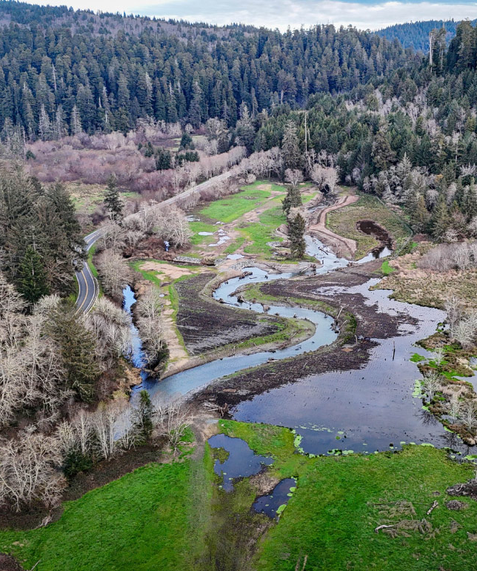
HOLISTIC BENEFITS OF RESTORATION
Ecology
Hydrology
Eco-cultural
Carbon
Water quality
Image Credit: California Trout

Slide 6
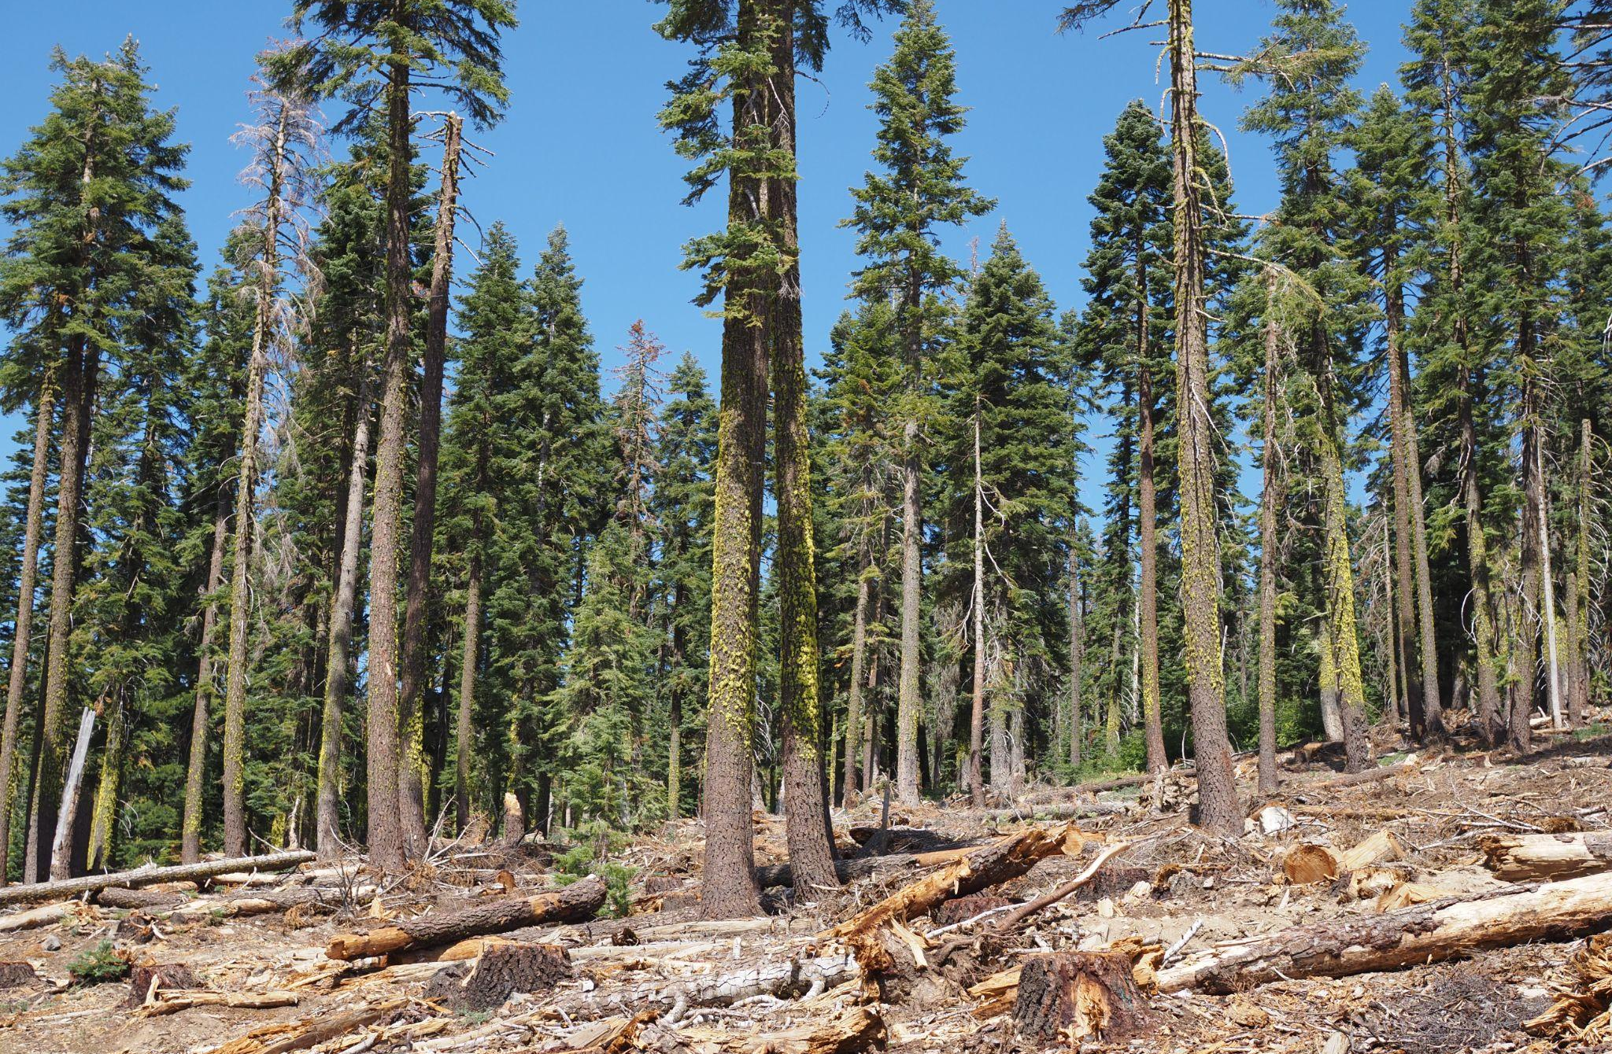
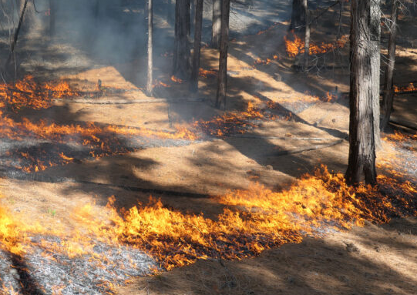
RESTORATION STRATEGIES
Forests
Hand and mechanical thinning
Prescribed burning, cultural burning, managed wildfire
Image Credit: UC ANR

Slide 7
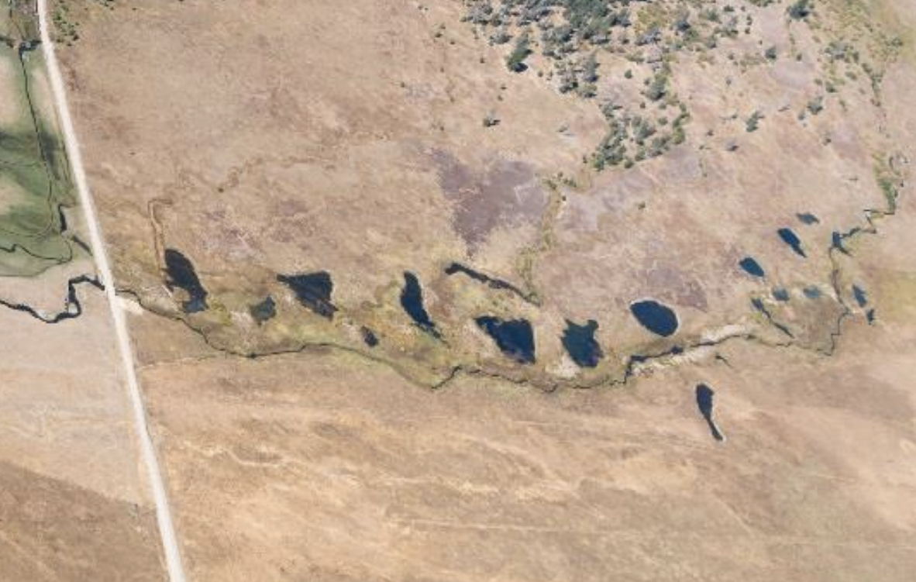
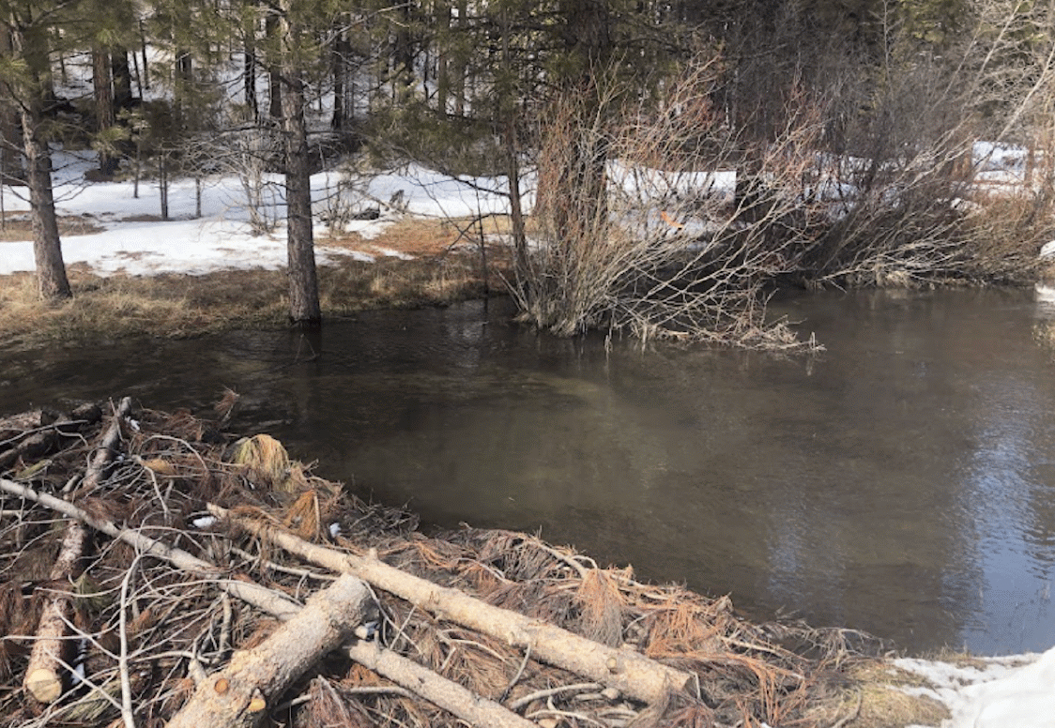
RESTORATION STRATEGIES
Meadows
Pond-and-plug restoration
Beaver dam analogs (BDAs)/ Low-tech Process Based Restoration (LT-PBR)
Image Credit: Sevier et al. 2024, Pope et al 2018

Slide 8
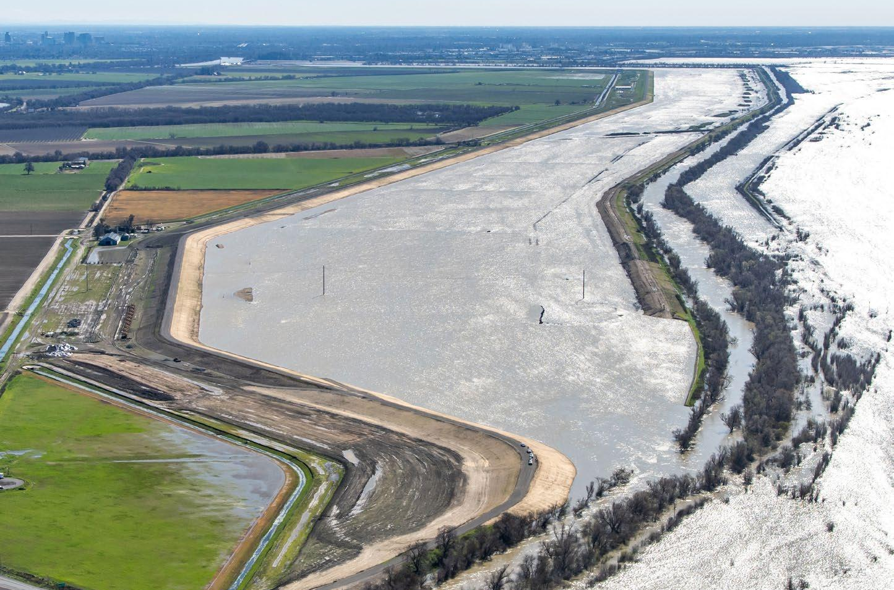
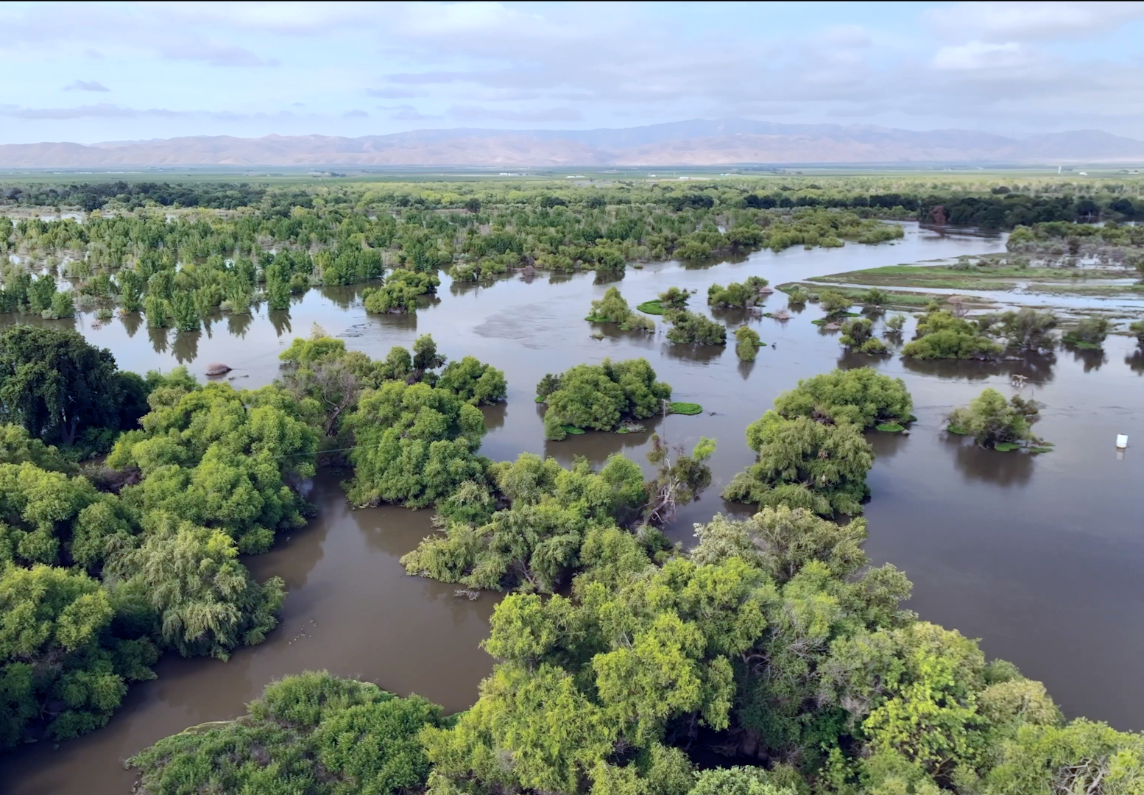
RESTORATION STRATEGIES
Floodplains
Levee setbacks, breaches, and removal
Riparian restoration
Image Credit: River Partners, Jacobs

Slide 9
METRICS
Notes:
The goal is not to predict the outcomes of given restorations; goal is to identify defensible estimates of restoration outcomes that we can apply in our scenario
Ranges are based on high and low end results from reviewed literature
Metrics will be reviewed in an upcoming expert forum

Slide 10
UPLAND RESTORATION BENEFITS
 | Hydrology | Ecology | Ecocultural | Carbon | Water Quality
Forests | Reduced ET Increased runoff Snowpack | Reduced forest cover Wildlife habitat | Increased opportunities for cultural practice; application of ITEK and stewardship | Reduced wildfire emissions | Reduced water supply risk
Meadows | Increased GW elevation Increased ET Reduced flood peak | Increased wetland cover Wildlife habitat Wildfire resistance | Increased opportunities for cultural practice; application of ITEK and stewardship | Carbon storage | Sediment capture Temperature change Pollutant removal
Flood- plains | Increased GW recharge Flood risk reduction | Ecosystem productivity Veg cover change | Increased opportunities for cultural practice; application of ITEK and stewardship | Soil carbon storage Veg carbon storage | Pollutant removal

Slide 11
METRICS - FORESTS
Benefit Assessed | Proposed Metric
Decreased evapotranspiration | Range: .47 - .57 AF/acre/year Avg: .54 AF/acre/year
Increased runoff | Range (North-Central): 0.16 - .45 AF/year/acre treated Range (South): 0 - 0.16AF/year/acre treated
Effects on snowpack | variable - dependent on treatment type and climate, topography, pre-existing veg
Decrease in forest density | 25-50% forest basal area reduction
Forest cover change | 22 - 24% decrease in forest cover over 50 years
Improved vegetative forest health | Reduced drought mortality, reduced susceptibility to disease, increased resilience to climate change, reduced wildfire risk, resistance to type conversion
Wildlife habitat | Increased forest opening habitat; short term habitat reduction/long-term stabilization for old world species; benefits from pyrodiversity
Ecocultural restoration | Promotes favored understory species, enables cultural practices
Reduced carbon emissions from wildfire | Range: 630 - 3,810 g/m2 Average: 1,717 g/m2
Avoided post-wildfire risks | Avoids heavy metal contaminants from burned communities; HABs risks; large woody debris
Reduced risk to water quality | Avoids post-wildfire sedimentation, contamination, disruption to ecosystem processes

Slide 12
METRICS - MEADOWS
Benefit Assessed | Proposed Metric
Increased groundwater elevation | Range: .14 - .40m Average: .27m
Depth to groundwater | pre-restoration range: .39-1.86 m avg: .862 m post-restoration range: .32 - .82 m avg: .58m
Increased evapotranspiration | Range: .43 - .68 AF/year/acre
Streamflow timing - flood peak reduction | Range: 10-25% Average: 17%
Streamflow magnitude | No clear consensus
Increased wetland cover | pre-restoration range: 1.71 - 50.04% wetland average: 16.65% post-restoration range: 19.5 - 67.29% average: 35.73% AVG INCREASE: 215%
Fire resistance | Serve as fire breaks, provide refugia during and after fire
Wildlife | Improved habitat esp. For birds and amphibians
Ecocultural restoration | Promotes favored species, enables cultural transmission
Carbon storage | Range: 330.4 - 998.8 g/m2/yr Average: 632.85 g/m2/year
Sediment capture | Sediment capture raises channel beds, reduces downstream sediment flows
Temperature | Increased temperature diversity
Pollutant removal | Filtration of pathogens, potential filtration of nitrates, phosphates

Slide 13
METRICS - FLOODPLAINS
Benefit Assessed | Proposed Metric
Increased groundwater recharge | Range: 0.0633 - 0.215 AF/acre/day inundated avg: 0.139 AF/day inundated
Flood attenuation benefits | Reduced water surface elevation for given flow; delayed peak flow; reduced impact of flooding due to removal of high-value land uses from flood plain
Reduced irrigation demand | .687 AF/acre/year
Vegetation cover change | Riparian habitat: 59% increase Wetland/marsh habitat: 10% increase
Food web/ecosystem productivity | Productivity increases with inundated habitat
Improved wildlife habitat | Improved habitat for waterfowl, other migratory and resident bird species; improved habitat supporting multiple life history paths for salmon and other fish; additional habitat for insects, deer, other fauna
Ecocultural restoration | Promotes favored species, enables cultural transmission
Carbon storage | Soil C range: 87-100 g/m2/year avg: 93.5 g/m2/year Veg C range: 6800 - 27930 g/m2 at maturity avg: 17,176 g/m2 at maturity
Denitrification | Floodplains remove nitrogen from floodwaters during inundation
Notes:
https://docs.google.com/spreadsheets/d/1HePOSbHNxfDrzr3ZP9yvctAQ3gdHcoLnqJHB9fdch2Q/edit?gid=830690597#gid=830690597

Slide 14
SCENARIOS
Notes:
The goal is not to predict the outcomes of given restorations; goal is to identify defensible estimates of restoration outcomes that we can apply in our scenario
Ranges are based on high and low end results from reviewed literature
Metrics will be reviewed in an upcoming expert forum

Slide 15
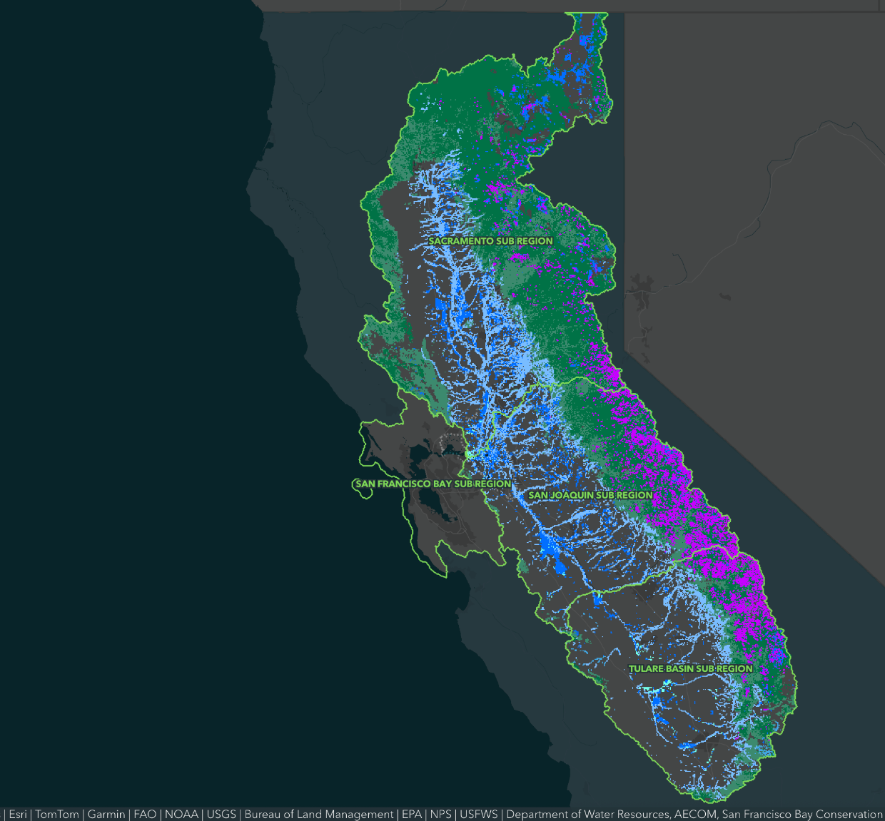
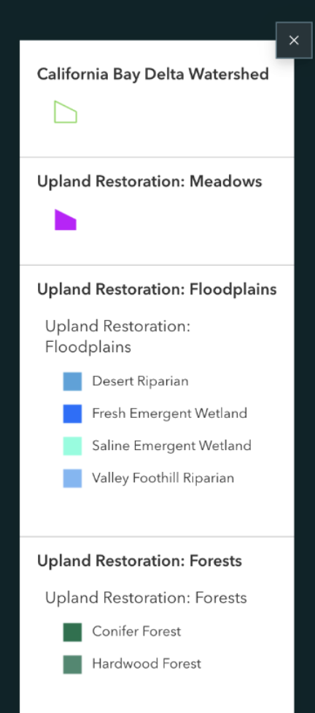
CURRENT HABITAT EXTENT

Slide 16
RESTORATION SCENARIOS
 | Prioritize Forests | Prioritize Meadows | Prioritize Floodplains
Minimal restoration | MIN-FOREST 12% of forest acres 10% of meadow acres 10% of floodplain “opportunities” acres | MIN-MEADOW 4% of forest acres 30% of meadow acres 10% of floodplain “opportunities” acres | MIN-FLOODPLAIN 4% of forest acres 10% of meadow acres 30% of floodplain “opportunities” acres
Medium restoration | MED-FOREST 30% of forest acres 40% of meadow acres 40% of floodplain “opportunities” acres | MED-MEADOW 16% of forest acres 75% of meadow acres 40% of floodplain “opportunities” acres | MED-FLOODPLAIN 16% of forest acres 40% of meadow acres 75% of floodplain “opportunities” acres
Maximal restoration | MAX-FOREST 60% of forest acres 100% of meadow acres 100% of floodplain “opportunities” acres | MAX-MEADOW 40% of forest acres 300% of meadow acres 100% of floodplain “opportunities” acres | MAX-FLOODPLAIN 40% of forest acres 100% of meadow acres 100% of floodplain “needs” acres

Slide 17
RESULTS
Notes:
The goal is not to predict the outcomes of given restorations; goal is to identify defensible estimates of restoration outcomes that we can apply in our scenario
Ranges are based on high and low end results from reviewed literature
Metrics will be reviewed in an upcoming expert forum

Slide 18

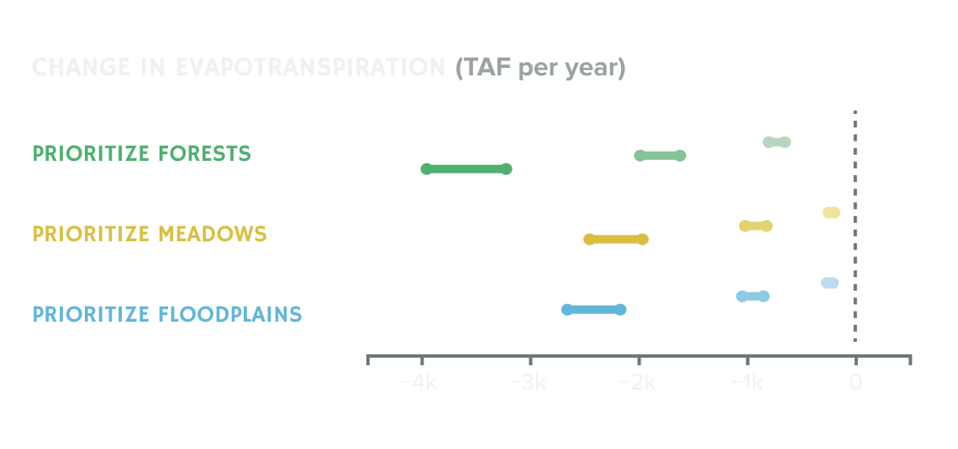
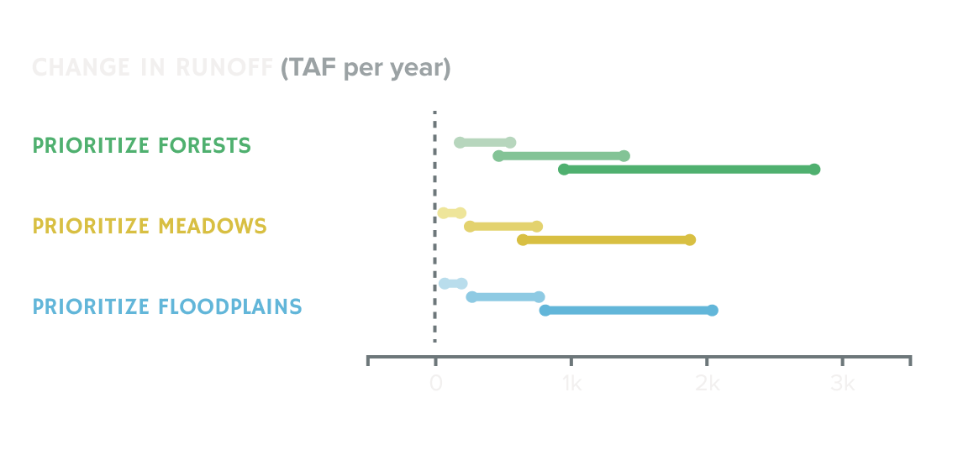
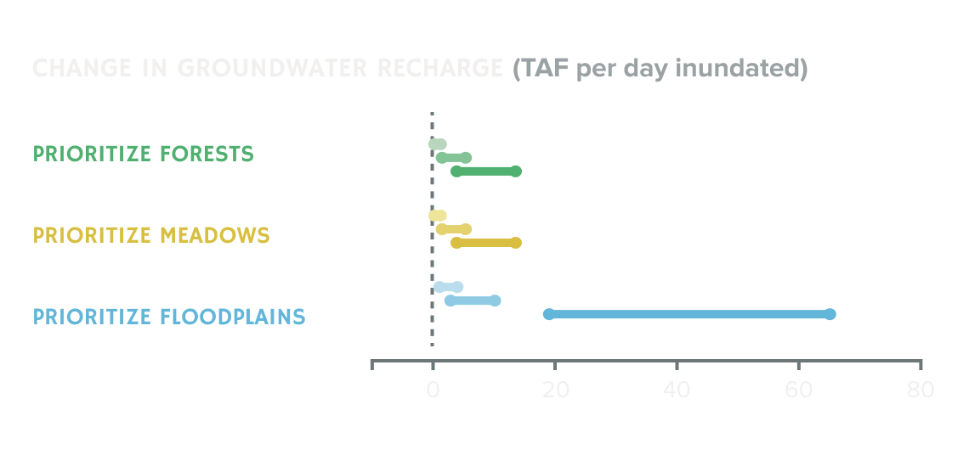
HYDROLOGY
Reduced ET translates to increased runoff
Floodplain restoration creates opportunities for groundwater recharge
Wide ranges reflect uncertainty, geographic/climatic variability

Slide 19
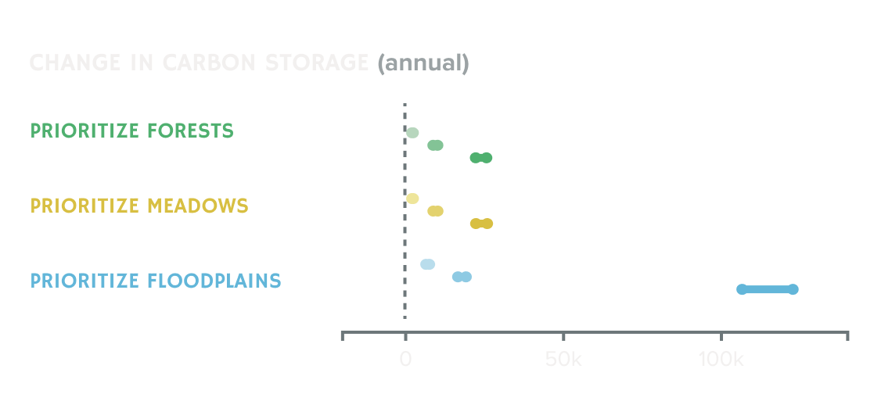
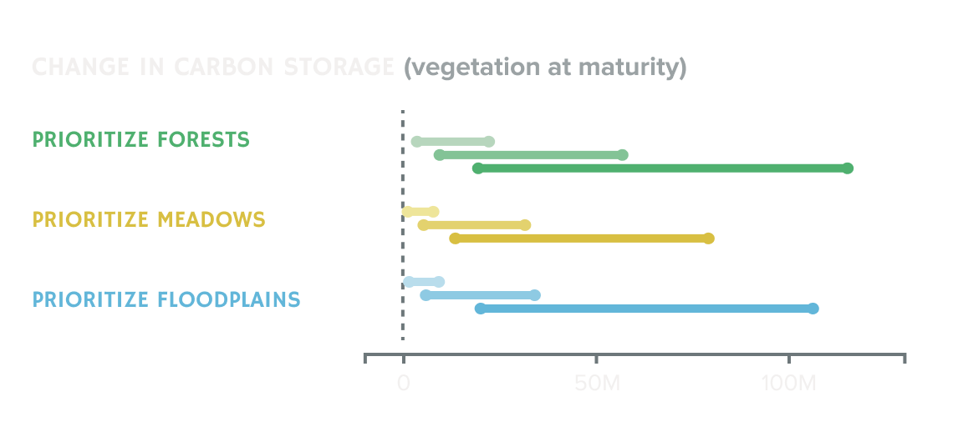
CARBON
(MG)
Scenarios prioritizing floodplain restoration augment annual and vegetative C storage
Meadow restorations, although smaller in area, store significant soil carbon
Scenarios prioritizing forest restoration support forest C stabilization
(MG)

Slide 20
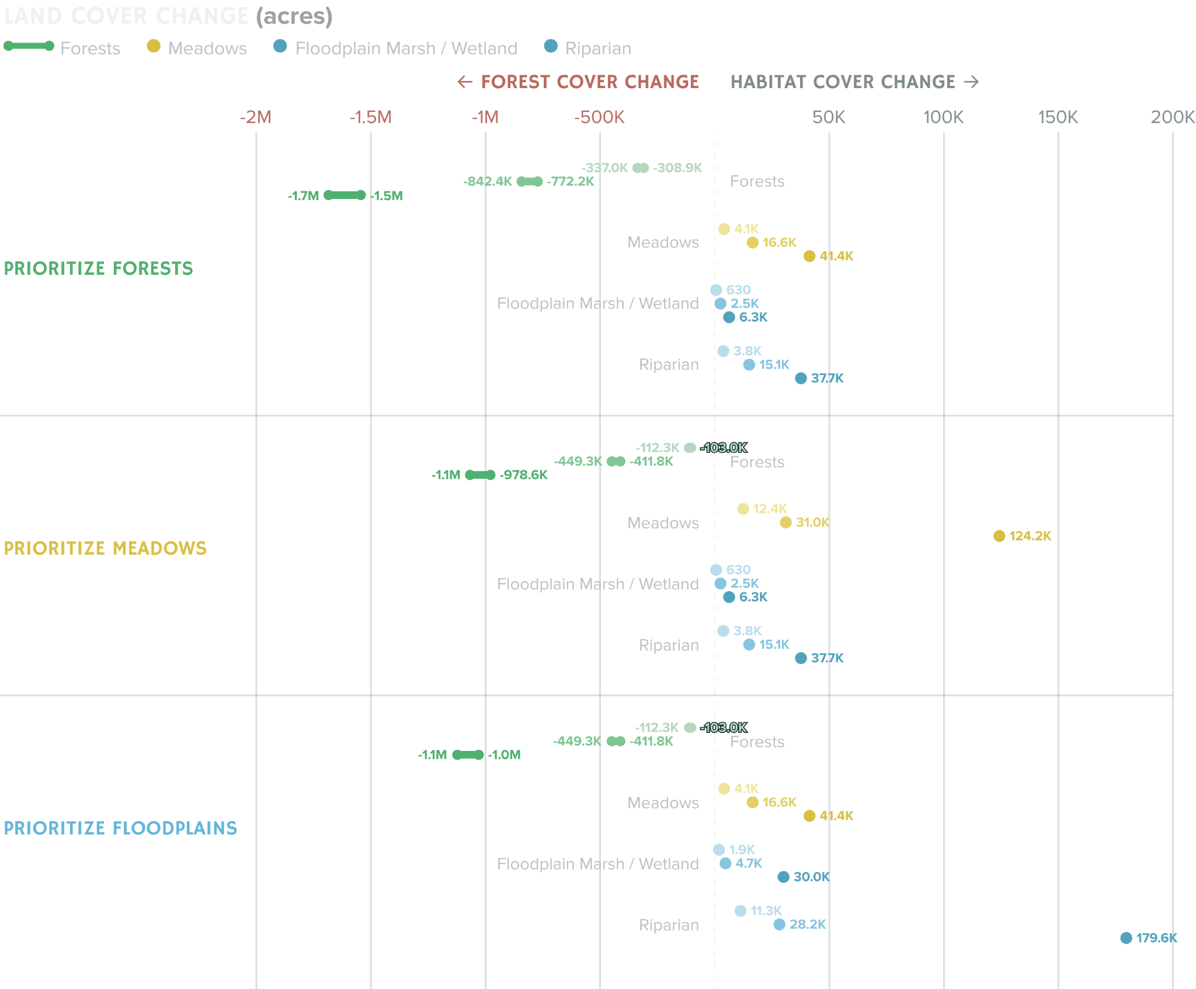
LAND COVER CHANGE
Restorations dramatically expand rare meadow, marsh, and riparian habitat
Implementing managed wildfire leads to reduced forest cover

Slide 21
QUALITATIVE BENEFITS
 | Hydrology and Water Quality | Ecology | Ecocultural
Forests | Snowpack Reduced water quality risk | Wildlife habitat | Increased opportunities for cultural practice and transmission; application of Indigenous TEK and reciprocal land stewardship
Meadows | Sediment capture Change in temperature Pollutant removal | Wildlife habitat Wildfire resistance | Increased opportunities for cultural practice and transmission; application of Indigenous TEK and reciprocal land stewardship
Flood- plains | Flood risk reduction Pollutant removal | Ecosystem productivity | Increased opportunities for cultural practice and transmission; application of Indigenous TEK and reciprocal land stewardship

Slide 22
UNCERTAINTIES
Climate variability: How will climate change affect the relationship between forest restoration, snowpack, evapotranspiration, and runoff?
Meadow hydrology: What are the long-term effects of meadow restoration on meadow hydrology, including the timing and volume of streamflow?
Flood attenuation: How do local-level benefits of levee setbacks scale up to influence watershed-level flood risk, especially in the Delta?

Slide 23
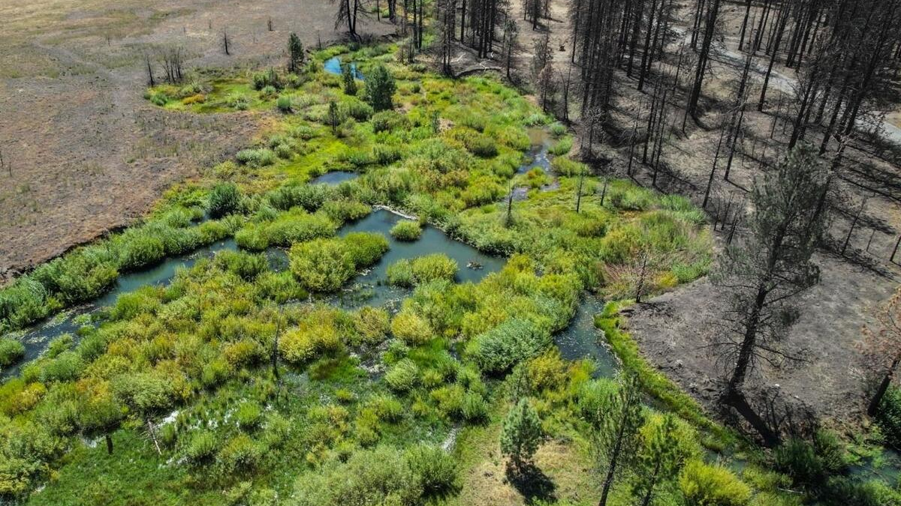
THANK YOU!
Contact: mfgallagher@ucdavis.edu / bmilligan@ucdavis.edu
Visualizations: Yun-Hsin Kuo, UC Davis
Image Credit: Emily Fairfax

